Slide 1


Quality Control Reporting with Quarto
U.S. Fish and Wildlife Service
Jason Ross
Midwest Fisheries Center Data Branch, Onalaska, WI
Jacob Cochran
Lower Great Lakes Fish and Wildlife Conservation Office, Basom, NY
Jonah Withers
Conservation Genetics Laboratory, Anchorage, AK
Notes:
JW

Slide 2
Course Overview
Introduction to Quarto in R
Nuts and bolts
You will have to knowledge to start your own
Disclaimer: Jake, Jonah, and I have done a fair amount of work with R Markdown and have only begun to explore Quarto. We certainly do not have all answers. Quarto is a big world and we have probably only scratched the surface on the capabilities!
Notes:
JW

Slide 3
What is Quarto?
Next gen version of R Markdown from Rstudio
Uses Knitr to render
Compatible with R Markdown
Multiple languages and output types (e.g., HTML, .pdf, powerpoints, dashboards)
Easy to transition from R Markdown to Quarto
May be easier to learn from scratch
R Markdown is not going away
Knit with parameters

Slide 4
Why Automate QC Reports?
Increase efficiencies
Automate QC checks
Eliminate redundancy
Reduce errors in QC checks
Document errors and corrected items

Slide 5
Quality Control Criteria
QC criteria will be specific to individual projects
Project Metrics
Were the minimum number of samples or lengths collected?
Were samples shipped correctly?
Were vouchers validated in the lab?
Data Structure
Missing fields
Data
Missing values
Outliers
Incorrect units (mm vs. inches)
Naming conventions or typos
Spatial
Duplicates

Slide 6
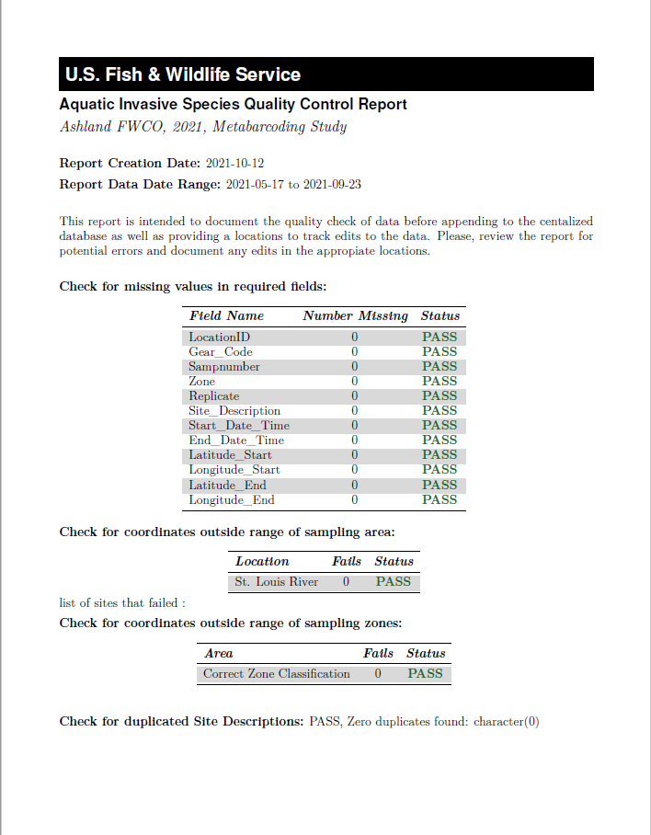
QC Report Examples
Ashland FWCO Metabarcoding Study
Project Metrics
Correct number of samples
Data
Missing values
Coordinates check
Duplicate site names
Outliers of counts and lengths
Species Names

Slide 7
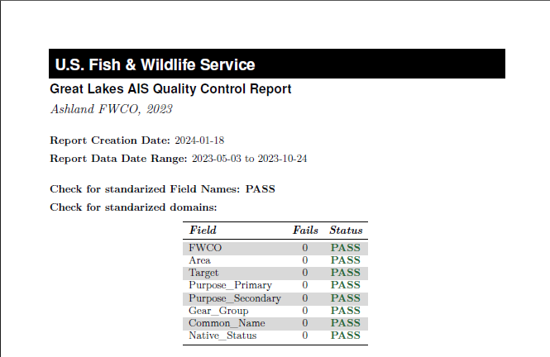
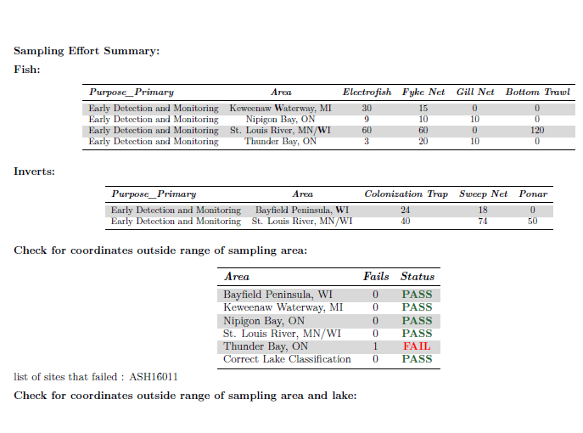
QC Report Examples
Great Lakes AIS EDM Data Append
Project Metrics
Effort Allocation
Locations
Data Structure
All Columns and tables
Data
Missing values
Coordinates check
Duplicate site names
Outliers of counts and richness
Data domains

Slide 8
Anatomy or Quarto
YAML Header
With metadata about the document
Output controls
Text
Source vs. visual editor
Source is what you would see with R Markdown
Visual is a bit more user friendly
Code Chunks
Chunk options with #| instead being within {}

Slide 9
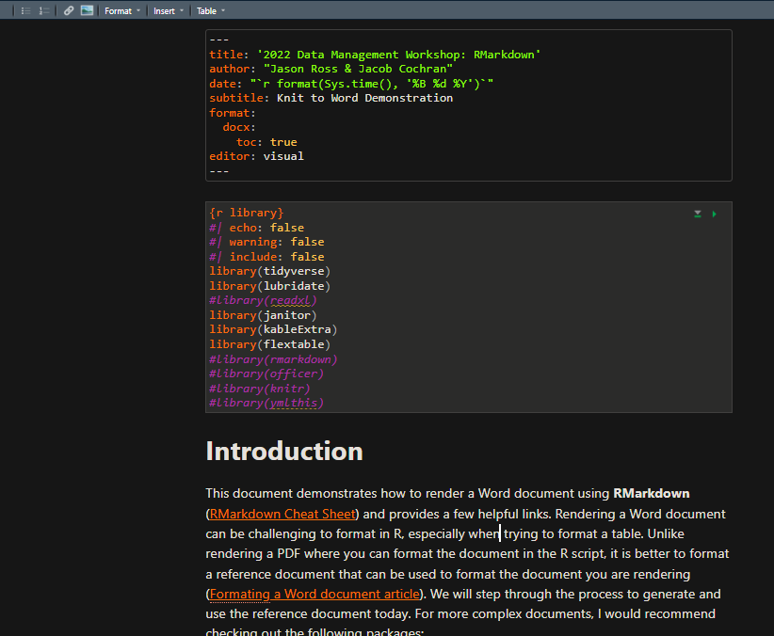
Anatomy of an R Markdown File
YAML Header
Code Chunk
Text
Notes:
JC
There are three parts of a Rmd. The YAML header, the main text, and code chunks.

Slide 10
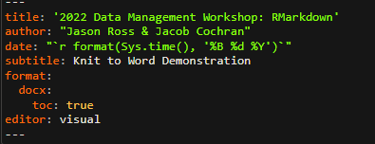
Anatomy of an R Markdown File: YAML Header
Metadata!
Processed during rendering
Read by Pandoc, rmarkdown and knitr
Parameters
Notes:
JC
Every Rmd document starts with a YAML which is a recursive acronym for “YAML ain’t markup language”. YAMLs always start and end with “---” and include the metadata of your document such as the title of the document, author, and an output which specifies which format the document will be written in. Behind the scenes, your R Markdown will be knit to a markdown file which is then read by Pandoc. Pandoc reads the YAML to know which file type to write the document to.

Slide 11
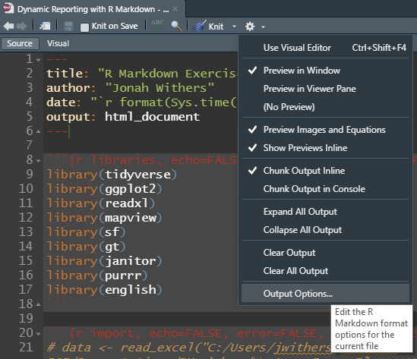
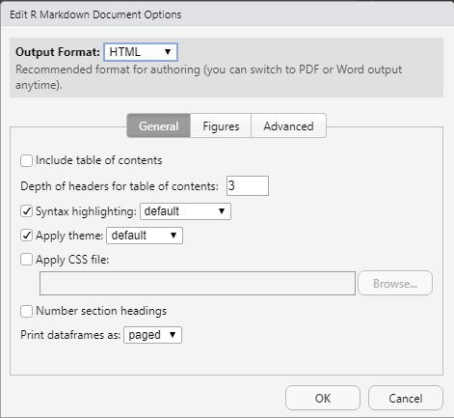
YAML Options
https://cran.r-project.org/web/packages/ymlthis/vignettes/yaml-fieldguide.html
https://pandoc.org/MANUAL.html#extension-yaml_metadata_block
Notes:
JW
There are a lot of options you can specify within the YAML section. They can be very simple or complicated and a little tricky to set them up at first. You can reference these sites below for help or, in Rstudio, you can select the gear icon at the top and select “output options…” which helps you set up the YAML
Helpful information on: YAML https://pandoc.org/MANUAL.html#extension-yaml_metadata_block
https://cran.r-project.org/web/packages/ymlthis/vignettes/yaml-fieldguide.html

Slide 12
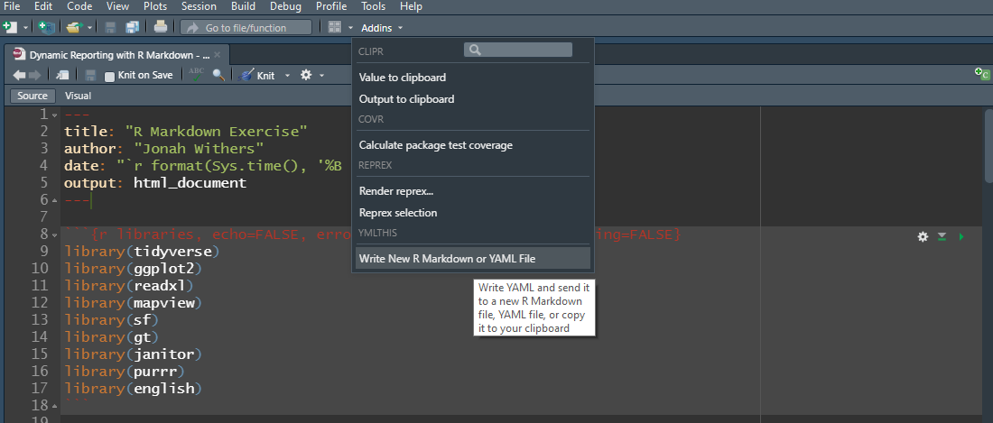
YAML Options
Package = “ymlthis”
Notes:
JW
If you still need help, you can try the “ymlthis” package which adds a plugin to your Rstudio. By selecting the “Write New R Markdwon or YAML File” option under the Addins menu….

Slide 13
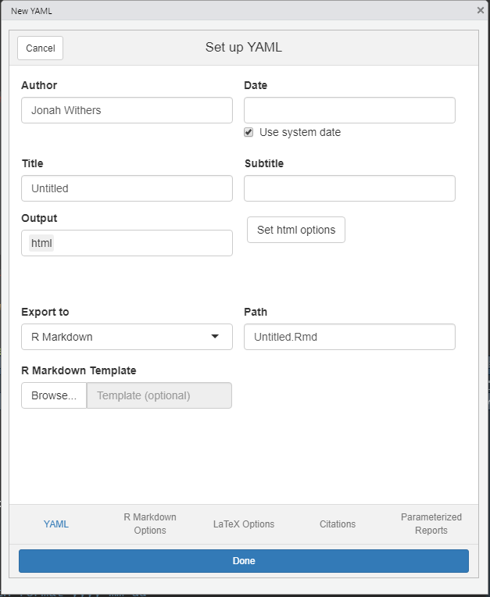
YAML Options
Package = “ymlthis”
Notes:
JW
A window pops up that helps you set up your YAML in a pretty user-friendly way.

Slide 14
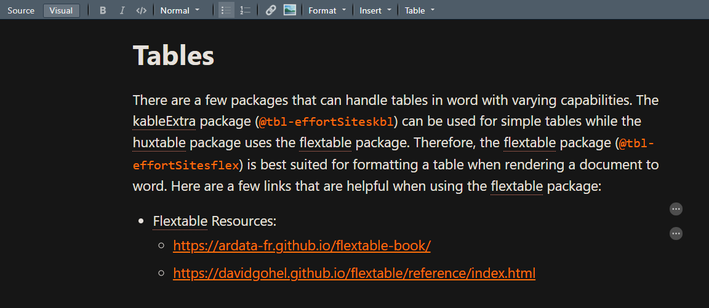
Anatomy of an R Quarto File: Text
More straightforward – text editorish
Combine text and code!
Document structure as well
Raw content – LaTeX or HTML
Notes:
JC
This section is where you can write you document text. One of the advantages of using R Markdown, is that it allows you to incorporate code within your text. In the example above, you can see the ‘r denotes inline code section. Note that in inline code and code chunks, the user specifies “r” after the ``` or ` This is because you can include various languages like python, SQL, R, or Julia so the user needs to specify which language they’re using. After the `r, the inline code filters and extracts data from the AIS_Salary_Budget_Log so as the data in budget log is updated, the text will be updated the next time the R markdown file is run.

Slide 15
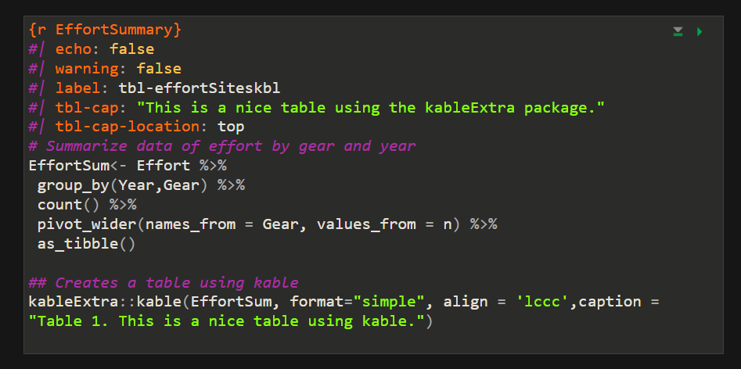
Anatomy of an R Quarto File: Code Chunks
Knitting environment, code input and chunk options
Notes:
JC
Code chunks are what make Rmd so great. They allow you to integrate code into your document so that it is dynamic. Code chunks always start will ```{r} and end with ```
A shortcut for inserting a code chunk is Cntrl + Alt + I
Alternatively, you can click the +C icon in the top right of the window.

Slide 16
Code Chunks
Provide title for chunk
No spaces or special characters
Chunk options (True/False)
Echo: include code chucks in output
Include: include chunks and results in output
Eval: whether chunk is run
Error: include errors
Message: include messages from code in the output
Warning: include warnings from code in the output
Notes:
JW
Note that in inline code and code chunks, the user specifies “r” after the ``` or ` This is because you can include various languages like python, SQL, R, or Julia so the user needs to specify which language they’re using
In code chunks, after the ```{r the user can provide a title for the code chunk. Its good practice to provide one to keep things organized, create a useable outline, and help troubleshoot the code if there’s an error.
After the title of the code chunk, the user can provide options which are separated by commas. There a ton of different options but here are some common ones used. https://rmarkdown.rstudio.com/lesson-3.html

Slide 17

Considerations
KISS
Less chances for package failures
Strive for full automation
Set up document for success
Reduce the errors by manually making updates
E.g., Year, number of samples, location names, etc.
Generalize where you can
Specificity may require updating paragraphs or code
Gold Standard for Automation
Update YAML and hit Run
Notes:
JC

Slide 18
Best practices
Folder structure
Directory, file, and R object naming
Create an R project
Bundles work into self-containing folder
Allows version control – Github
Reduces directory name changing
Keep code tidy and well-documented
Include comments
Include headers and subheaders
Short but descriptive (PBear_2020_harvest.csv)
No spaces or special characters (!@#$.)
Include a changelog (or README file) and keep it up to date!
Notes:
JW
Before we dive into R Markdown, we wanted to touch on a few best practices for project maintenance. When setting up a project you’ll want to think through your folder structure and naming schemas to help keep things organized in a logical manor. Remember to keep names descriptive but short and avoid using spaces or special characters (with the exception of underscores or hyphens). Be sure to include a changelog or README file so others can figure out the structure. And remember to keep it up to date!
When building R Markdown files, R scripts, notebooks, or apps its recommended you set up R projects. R projects allow you to bundle all the materials associated with the project into a self-containing folder. It also allows you to enable version control via Github or GitLab. Finally, R projects allow you to specify paths that are not user-specific.
Finally, we’d just like to remind everyone to include comments in their code where necessary and include headers and subheaders. During the demonstrations, we’ll show you how to set create and view these.

Slide 19
Tables
Knitr (kable): limited capabilities but works in all outputs
Reactable: interactive, searchable/filterable tables. HTML only
kableExtra: lots of customization. HTML and PDF only
Flextable: lots of customization. HTML, PDF, and office (word or power point)
Many more…
Notes:
There are a variety of options available for creating tables in Rmarkdown. Your needs and the document type you are rendering will influence your decision.

Slide 20
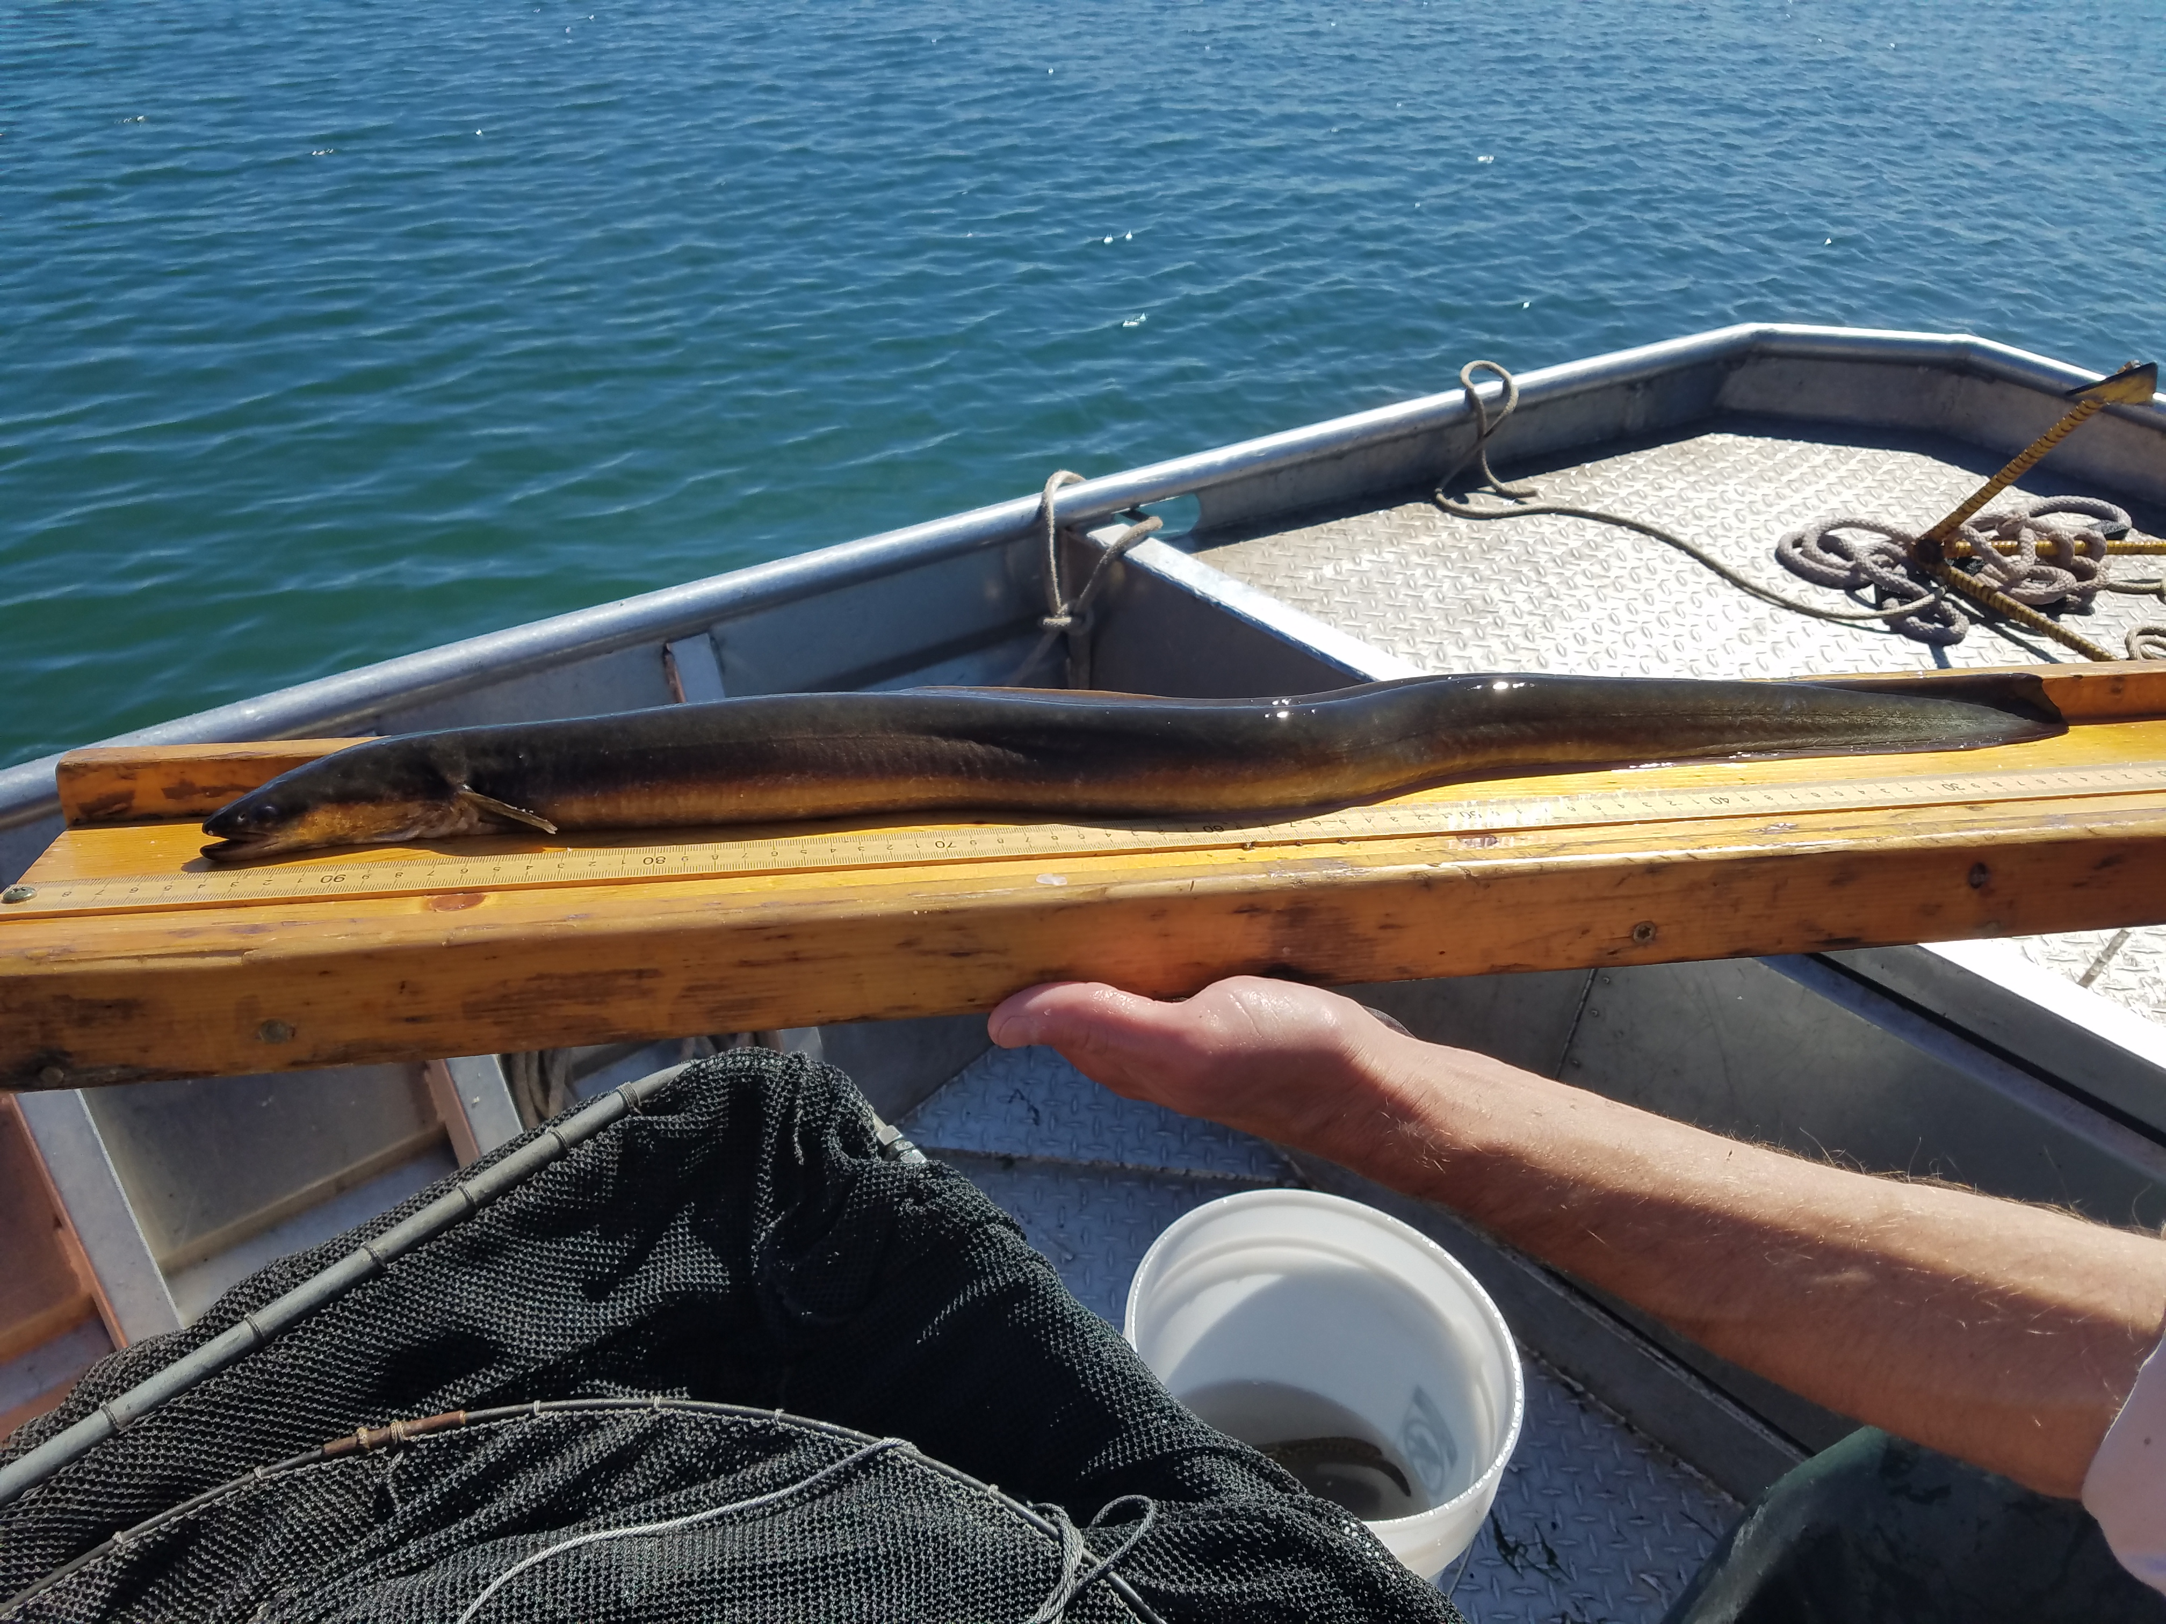


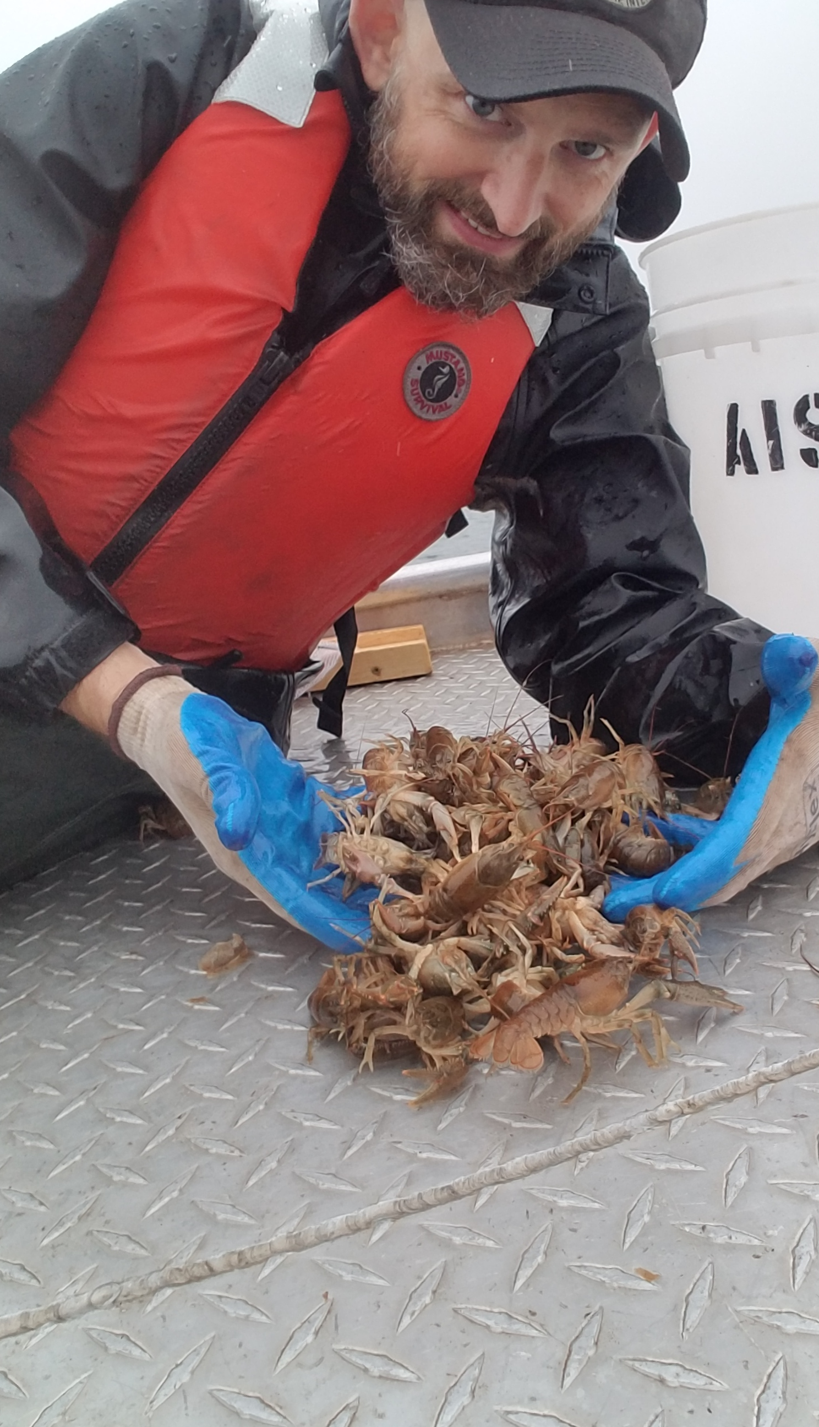
Microsoft Word Demonstration
Notes:
JW

Slide 21



PDF Demonstration
Notes:
JC

Slide 22



HTML Demonstration
Notes:
JW

Slide 23


Western Snowy Plover Exercise!

Slide 24

Q & A Session!
Notes:
Everyone

Slide 25
Shiny apps and dashboards
Shiny app
https://shiny.rstudio.com/
Flexdashboards
https://pkgs.rstudio.com/flexdashboard/
Shiny Dashboards
https://rstudio.github.io/shinydashboard/

Slide 26
Citation managers
Citation database
Allows you to store and manage research materials
Captures metadata from resources & allows you to generate and format bibliographies in citation styles you specify

Slide 27



Citation managers
 | Zotero | Mendeley | EndNote
Cost | Free and open source | Free | $250 for individual license (EndNote Basic free with limited capabilities)
Word processor compatibility | Word, Google Docs, LibreOffice, integration with R Markdown (R Studio v4.0) | Word, LibreOffice | Word, LibreOffice, Pages
Citation styles | Over 10,000 styles in .csl format | Over 10,000 styles in .csl format | 6,000 styles in .ens format

Slide 28
Having trouble downloading packages?
Are you connected to the network or VPN?
If so, try running this code in your console:
system2("setx", args = c("R_LIBCURL_SSL_REVOKE_BEST_EFFORT", "TRUE"))

Slide 29
Version Control
Git hub (https://github.com/)
Git lab (https://about.gitlab.com/)
Can either:
Initialize new git repository
Clone existing git repository
Check out GitHub tutorial here
Notes:
Popular version control platforms are Git hub https://github.com/ and Git lab https://about.gitlab.com/ To use these free platforms, create an account. Once you have an account, you can either initialize a new git repository or clone an existing one.
There’s a course-worth of material on git hub which we encourage you to check out but is beyond the scope of this course. McCrea Cobb put a great presentation together on using GitHub. We’ve provided the URL link here for you to check out on your own time.

